Slide 1
Visualization of mind inside the brain
Włodzisław Duch
Neurocognitive Laboratory, Center of Modern Interdisciplinary Technologies, NCU Dept. of Informatics, Faculty of Physics, Astronomy & Informatics, NCU Google: W. Duch
Information Visualization in Humanities, 23.03.2017

Slide 2
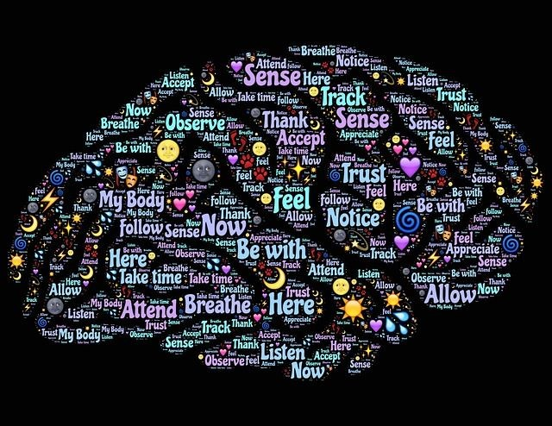
Questions
Cognitive InfoCommunication
Can we see minds in our brains?
Can we see culture?
Is the inner world really private?
Are my dreams private?
How are deep beliefs, conspiracy theories formed?
Previous talks on many approaches to visualization are on my page.

Slide 3
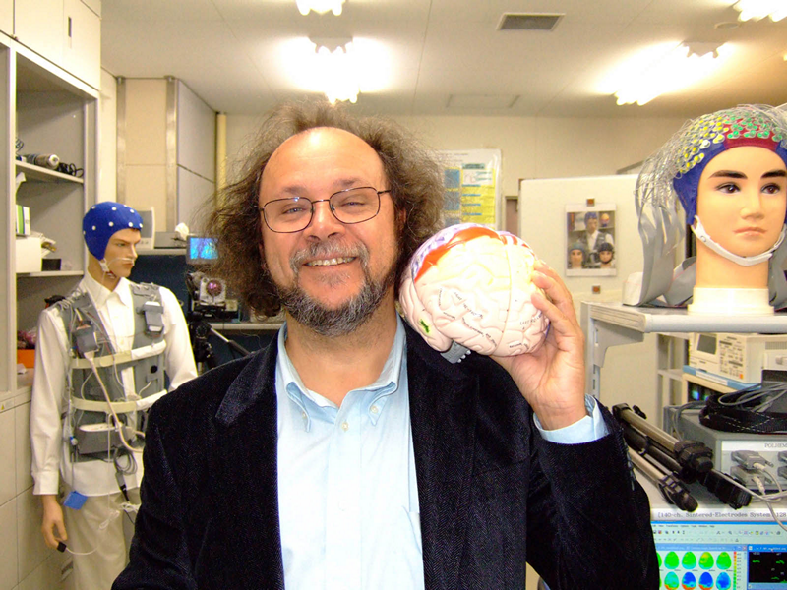
My favorite organ! Where is mind?

Slide 4
Soul or brain?
Soul or brain: what makes us human? Interdisciplinary Workshop, Faculty of Theology, Nicolaus Copernicus University + Insbruck + Pampeluna (10/2016). Almost no dualists are left even among theologians.

Slide 5
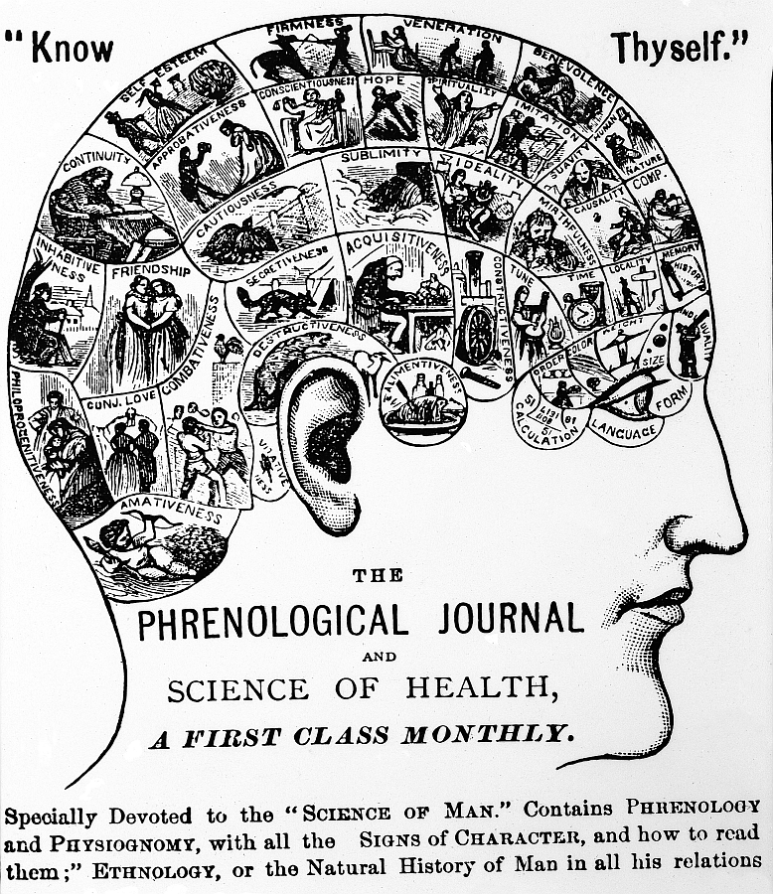
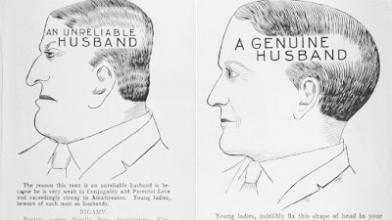
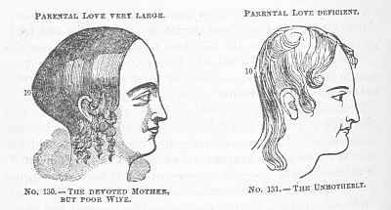
Phrenology
Phrenology was popular in 19 century. The scull was divided in 35 areas with specific functions.
Amativness, friendship, self esteem, hope, wit, veneration …

Slide 6
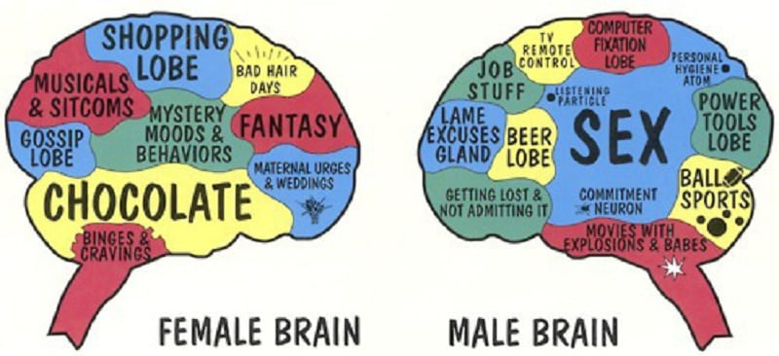
This is also not what we have in the brain …
But there are many neuromyth and pseudo-scientific organizations that promote ideas at this level.
Ex: Structogram Training System, Genetic Code for Personality.

Slide 7
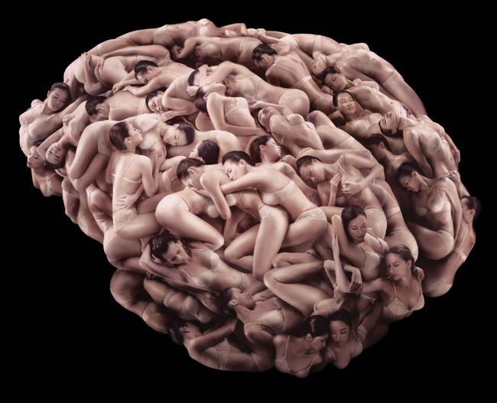
Real demons in our brains …
Can we see what goes on in human brains?

Slide 8
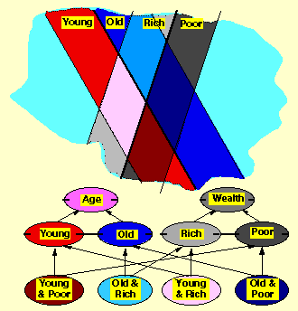
Psychological spaces
Psychological spaces:
K. Lewin, The conceptual representation and the measurement of psychological forces (1938), cognitive dynamic movement in phenomenological space.
George Kelly (1955), personal construct psychology, geometry of psychological spaces as alternative to logic.
A complete theory of cognition, action, learning and intention.
P-space: region in which we may place and classify elements of our experience, constructed and evolving, „a space without distance”, divided by dichotomies.
P-spaces (Shepard 1957-2001):
minimal dimensionality
distances that monotonically decrease
with increasing similarity
(multi-dimensional non-metric scaling).

Slide 9
Some connections
Geometric/dynamical ideas related to mind may be found in many fields:
Philosophy: Mind as motion, ed. R.F. Port, T. van Gelder (MIT Press 1995)
Linguistics: G. Fauconnier, Mental Spaces (Cambridge U.P. 1994). Mental spaces and non-classical feature spaces.
J. Elman, Language as a dynamical system (San Diego, 1997). Stream of thoughts, sentence as a trajectory in P-space.
Psycholinguistics: T. Landauer, S. Dumais, Latent Semantic Analysis Theory, Psych. Rev. (1997) Semantics requires about 300 dim. to capture associations.
M.J. Spivey, The Continuity of Mind (OUP 2007)
Neuroscience: Anderson, van Essen (1994): Superior Colliculus maps as PDFs
AI: problem spaces - reasoning, problem solving, SOAR, ACT-R
Folk psychology: to put in mind, to have in mind, to keep in mind, to make up one's mind, be of one mind ... (space).

Slide 10
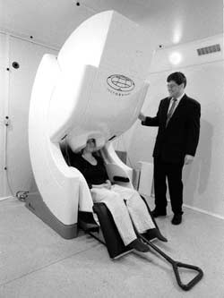
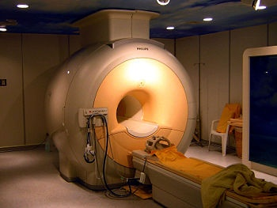
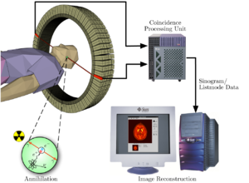
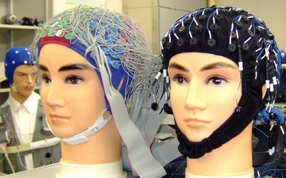
Neuroimaging

Slide 11
Neuroimaging techniques

Slide 12
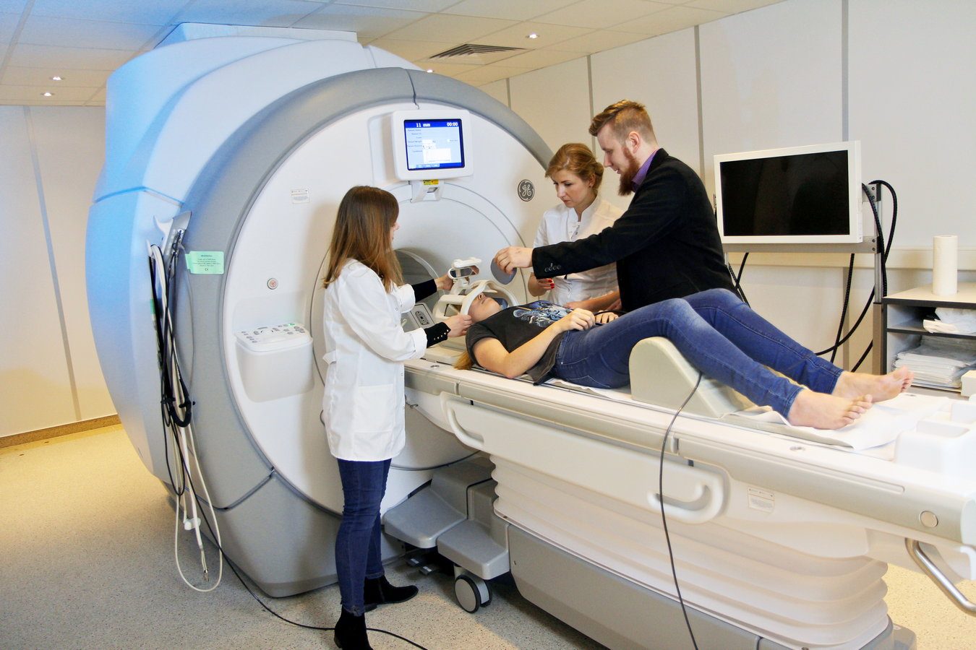
ICNT: scanner GE Discovery MR750 3T

Slide 13
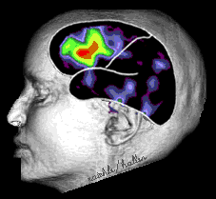
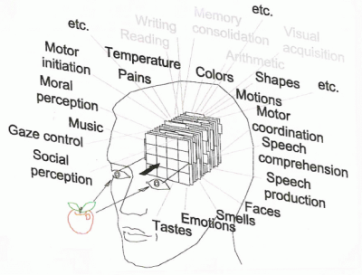
Geometric model of mind
Brain ⬄ Psyche
Objective ⬄ Subjective
Neurodynamics: bioelectrical activity of the brain, neural activity measured using EEG, MEG, NIRS-OT, PET, fMRI, other techniques.
Mapping S(M)⬄S(B) but how do we describe the state of mind?
Verbal description is not sufficient. A space with dimensions that measure different aspects of experience is needed.
Mental states, movement of thoughts ⬄ trajectories in psychological spaces.
Problem: good phenomenology. We are not able to describe our mental states.
Hurlburt & Schwitzgabel, Describing Inner Experience? MIT Press 2007

Slide 14
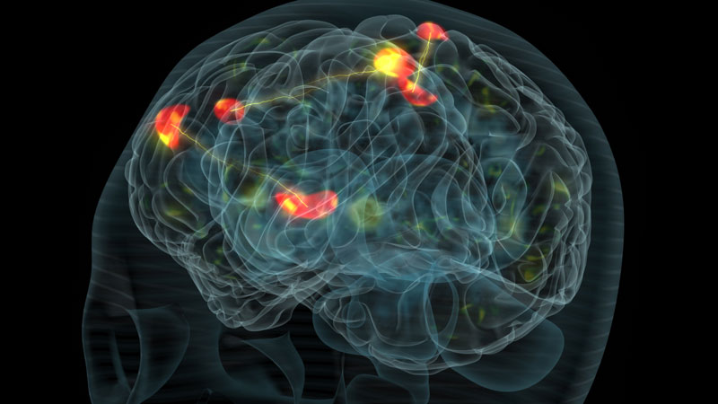
Thought: strong, coherent activation
Many processes go on in parallel, controlling the state of our bodies. Most are automatic, hidden from our Self. Processes implemented by subnetworks compete for access to the highest level of control, consciousness, using the winner-takes-most mechanism. Such processes may activate representaiton of Self in the brain.

Slide 15
Language activates most Broadman areas (av. 165 experiments).
Orange: functional links
M. Anderson, BBS 2010

Slide 16
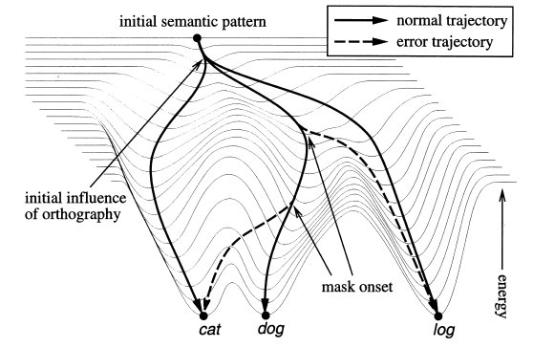
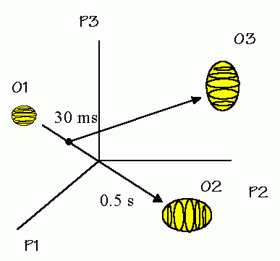
Energies of trajectories
P. McLeod, T. Shallice, D.C. Plaut, Attractor dynamics in word recognition: converging evidence from errors by normal subjects, dyslexic patients and a connectionist model. Cognition 74 (2000) 91-113.
M.J. Spivey, The Continuity of Mind (OUP 2007) New area in psycholinguistics: investigation of dynamical cognition, influence of masking on semantic and phonological errors.
Brain is a substrate in which mental processes take place.

Slide 17
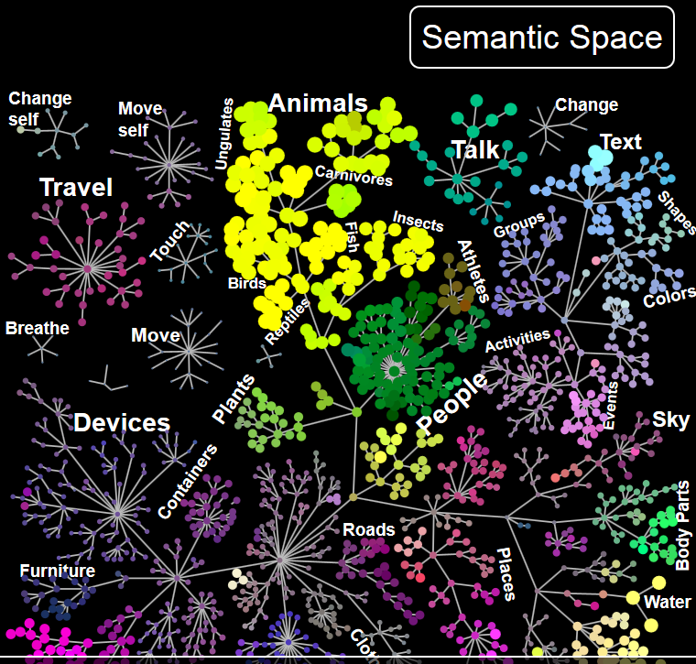
Words in the semantic space are grouped by their similarity. Words activate specific brain maps, similar words create similar maps. Each pixel may be activated by many words.

Slide 18
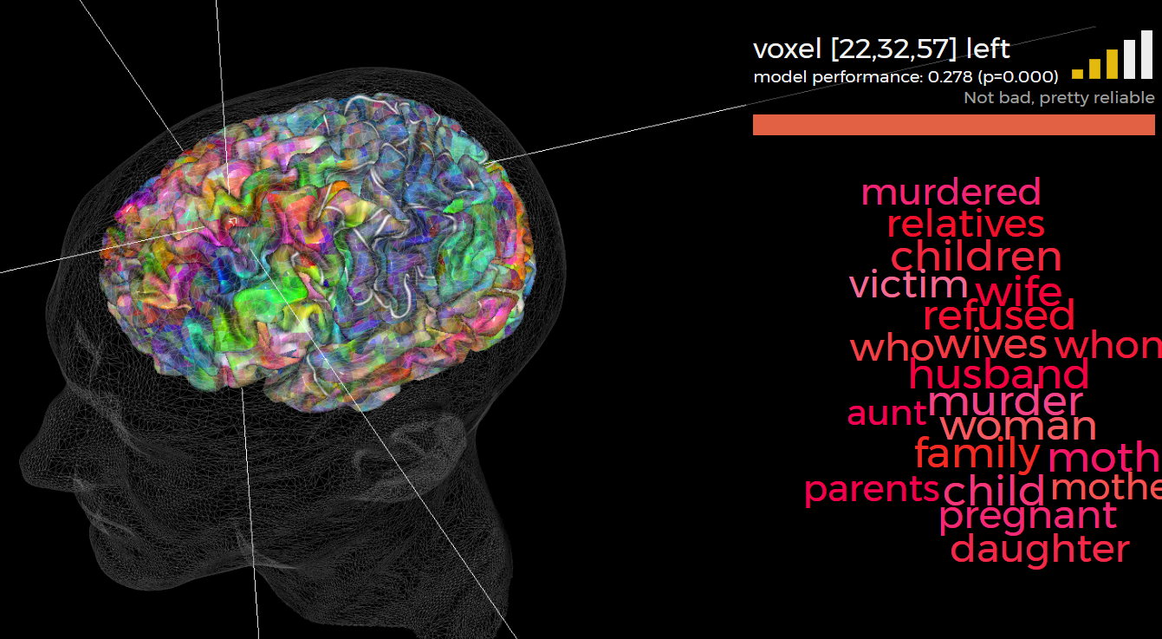
Each voxel responds usually to many related words, whole categories. http://gallantlab.org/huth2016/

Slide 19
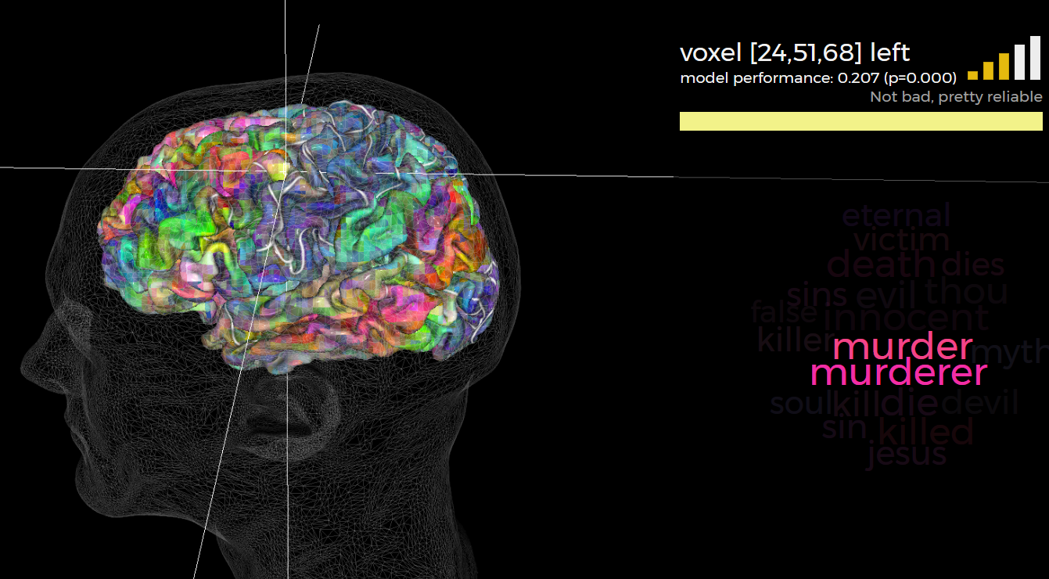
Voxel may also responds in quite specific way. http://gallantlab.org/huth2016/

Slide 20
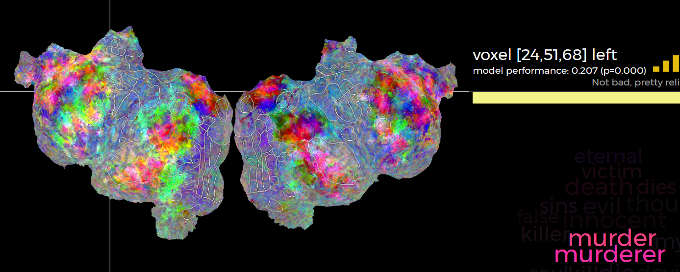
Each word activates a whole map of activity in the brain. Whole map for the word “murder” shown on the flattened cortex.
Why such activity patterns arise? Brain subnetworks connect active areas.
http://gallantlab.org/huth2016/ and short movie intro.

Slide 21
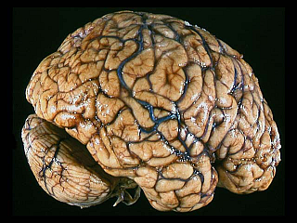
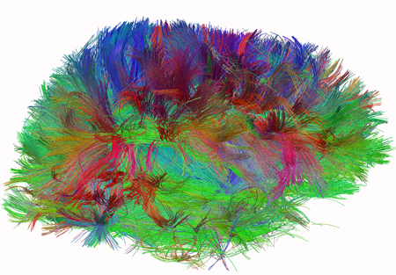
Neural determinism
Genetic determinism: general anatomy and functions of the brain.
Neural determinism: connections are formed by interactions with the environment, individual experiences and culture. We can only think in a way that is determined by neuronal activity! Neurodynamics is the true source of our thoughts, we confabulate in search for explanations. Understanding = activation of maps through connections. Metaphor: mind is the shadow of neurodynamics.

Slide 22
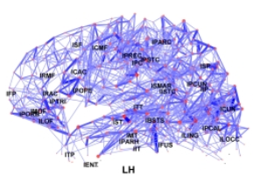
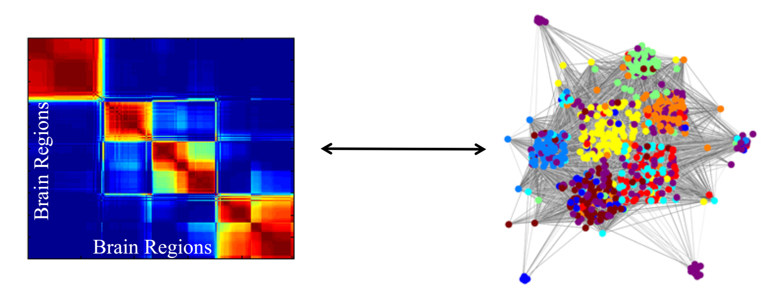
Neuronal subnetworks
Hierarchy and modularity is observed at large scale: several subnetworks responsible for arousal, attention, positive/negative valence, perception.
At the microcircuit level similar hierarchy/modularity is seen.

Slide 23
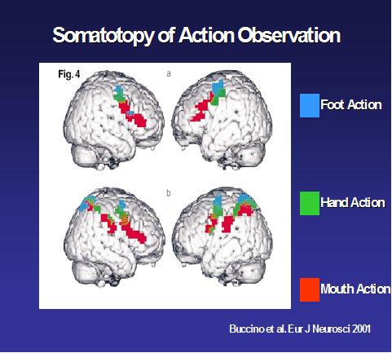
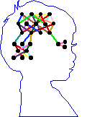
Words in the brain
Psycholinguistic experiments show that phonological representations activate categorical representations.
Acoustic signal => phoneme => words => semantic concepts.
Phonological processing precedes semantic by 90 ms (from N200 ERPs).
F. Pulvermuller (2003) The Neuroscience of Language. On Brain Circuits of Words and Serial Order. Cambridge University Press.
Action-perception networks inferred from ERP and fMRI
Left hemisphere: precise representations of symbols, including phonological components. Right hemisphere sees clusters of concepts, the gist.

Slide 24
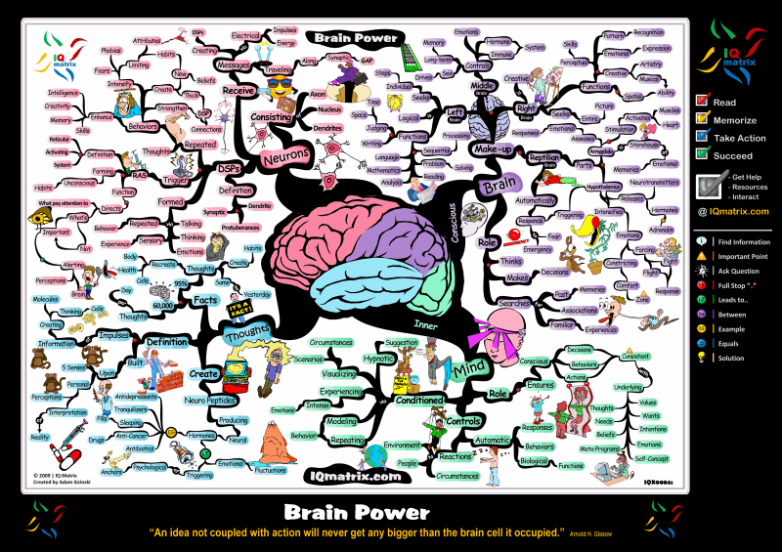
Mindmaps: concepts in memory

Slide 25
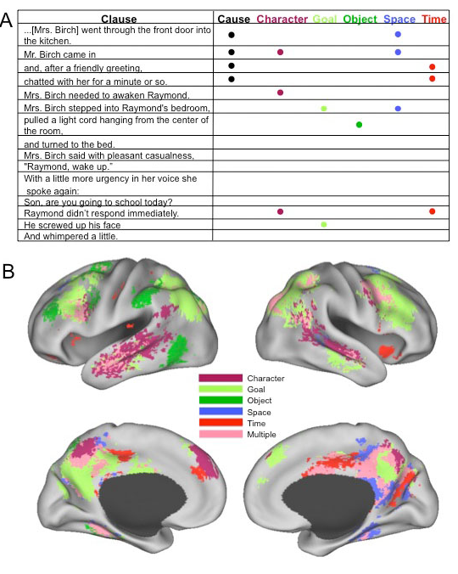
Narration
Nicole Speer et al. Reading Stories Activates Neural Repre-sentations of Visual and Motor Experiences. Psychological Science 2009; 20(8): 989–999.
Thought: spatiotemporal pattern
Meaning: always slightly different, depending on the context, but still may be clusterized into relatively small number of distinct meanings.
Sentences: trajectories in semantic space, building scenes, mind models with characters, objects, spatio-temporal relations.
www.nauka.gov.pl

Slide 26
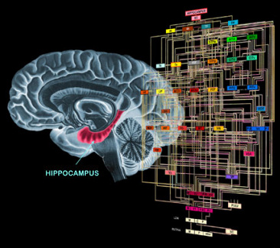
BICA, Brain-Inspired Cognitive Architecture
Understanding subtle mental processes requires a model that should show how internal states create narrative “stream of consciousness”.

Slide 27
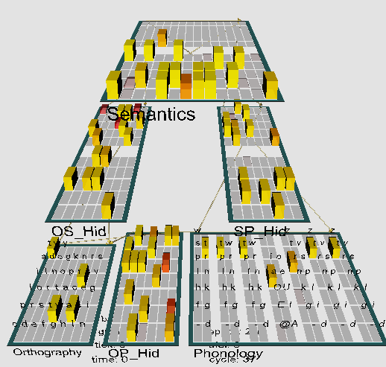
Model of reading
Emergent neural simulator:
Aisa, B., Mingus, B., and O'Reilly, R. The emergent neural modeling system. Neural Networks, 21, 1045-1212, 2008.
3-layer model of reading:
orthography, phonology, semantics, or distribution of activity over 140 microfeatures of concepts.
Hidden layers in between.
Learning: mapping one of the 3 layers to the other two.
Fluctuations around final configuration = attractors representing concepts.
How to see properties of their basins, their relations?

Slide 28
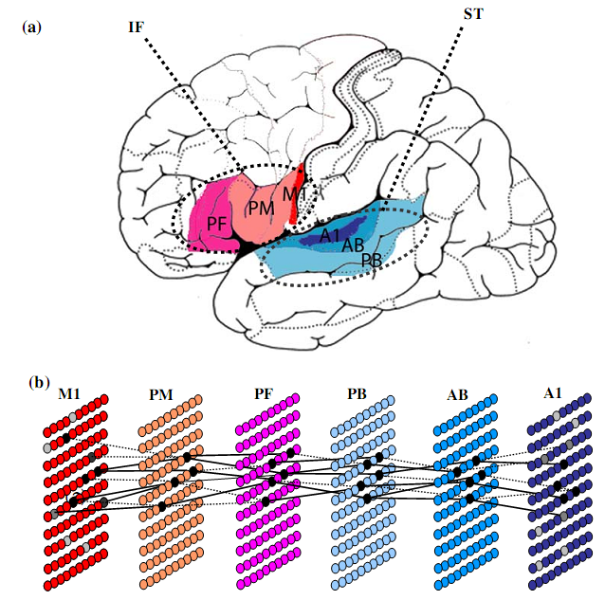
A more detailed model
Garagnani et al. Recruitment and consolidation of cell assemblies for words by way of Hebbian learning and com-petition in a multi-layer neural network, Cognitive Comp. 1(2), 160-176, 2009.
Primary auditory cortex (A1), auditory belt (AB), parabelt (PB, Wernicke’s area), inferior pre- frontal (PF) and premotor (PM, Broca), primary motor cortex (M1).

Slide 29
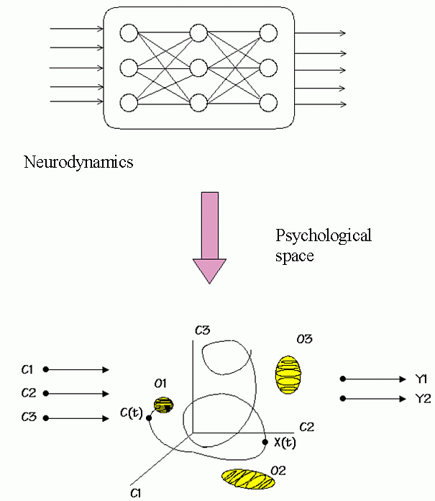
From neurodynamics we will move to dynamics in semantic spaces.
Our Viser Toolbox (Dobosz, Duch et al.) shows such trajectories.

Slide 30
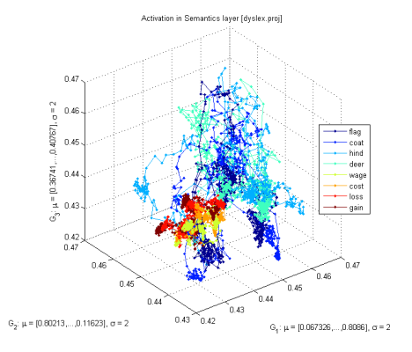
Attractors
Basins of attractors: input activations {LGN(X)}=> object recognition
Normal case: relatively large, easy associations, moving from one basin of attraction to another, exploring the activation space.
Without accommodation (voltage-dependent K⁺ channels): deep, narrow basins, hard to move out of the basin, associations are weak.
Attention results from:
inhibitory competition,
bidirectional interactive processing,
multiple constraint satisfaction.
Accommodation: basins of attractors shrink and vanish because neurons desynchronize due to the fatigue; this allows other neurons to synchronize, leading to quite unrelated concepts (thoughts).

Slide 31
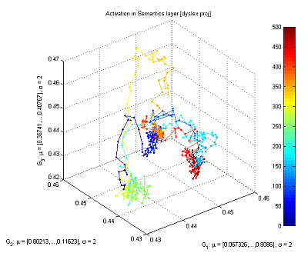
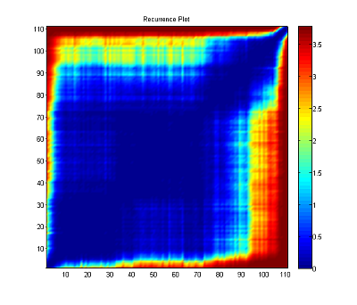
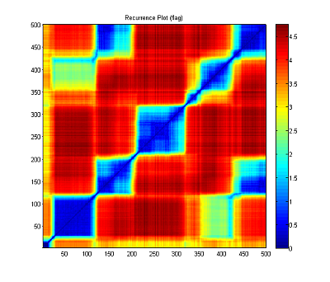
Recurrence plots
Starting from the word “flag”, with small synaptic noise (var=0.02), the network starts from reaching an attractor and moves to another one (frequently quite distant), creating a “chain of thoughts”.
Same trajectories displayed with recurrence plots, showing roughly 5 larger basins of attractors and some transient points.

Slide 32
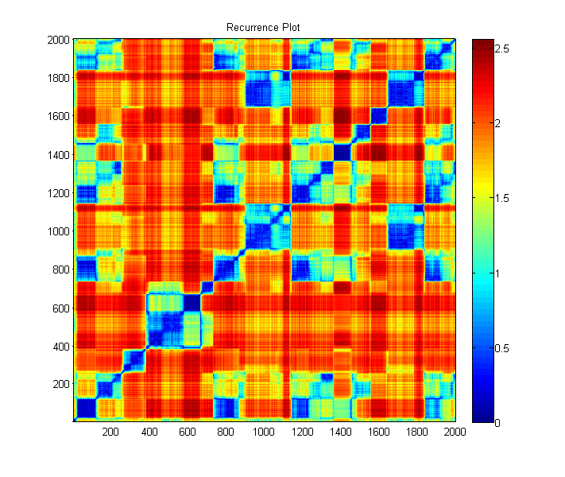
Activation of 140 semantic layer units starting from the word „gain”: rapid transitions between a sequence of related concepts is seen.

Slide 33
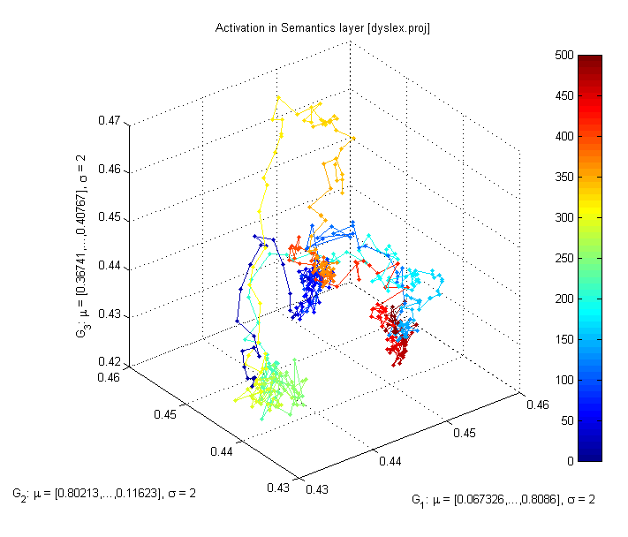
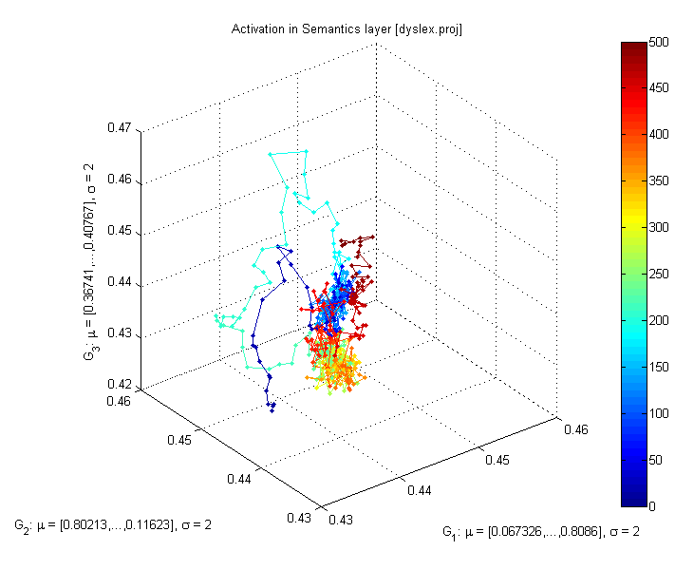
Normal-Autistic
Trajectories of semantic layer (140D) for the word „flag” depends on parameters that control neural depolarization (accomodation).
If spontaneous depolarization is weak (leaky ion channels are dysfunctional) few thought and percepts are generated, leading to the powveryt of mind, concentration on simple and strong stimuli.

Slide 34
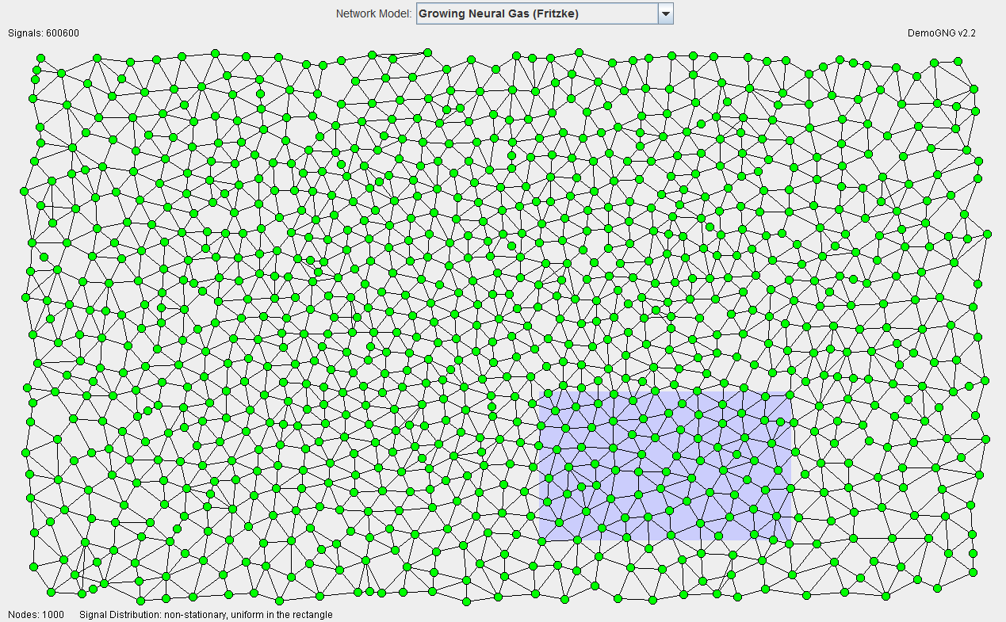
Internalization of environment
Episodes are remembered and serve as reference points, if observations are unbiased they reflect reality.

Slide 35
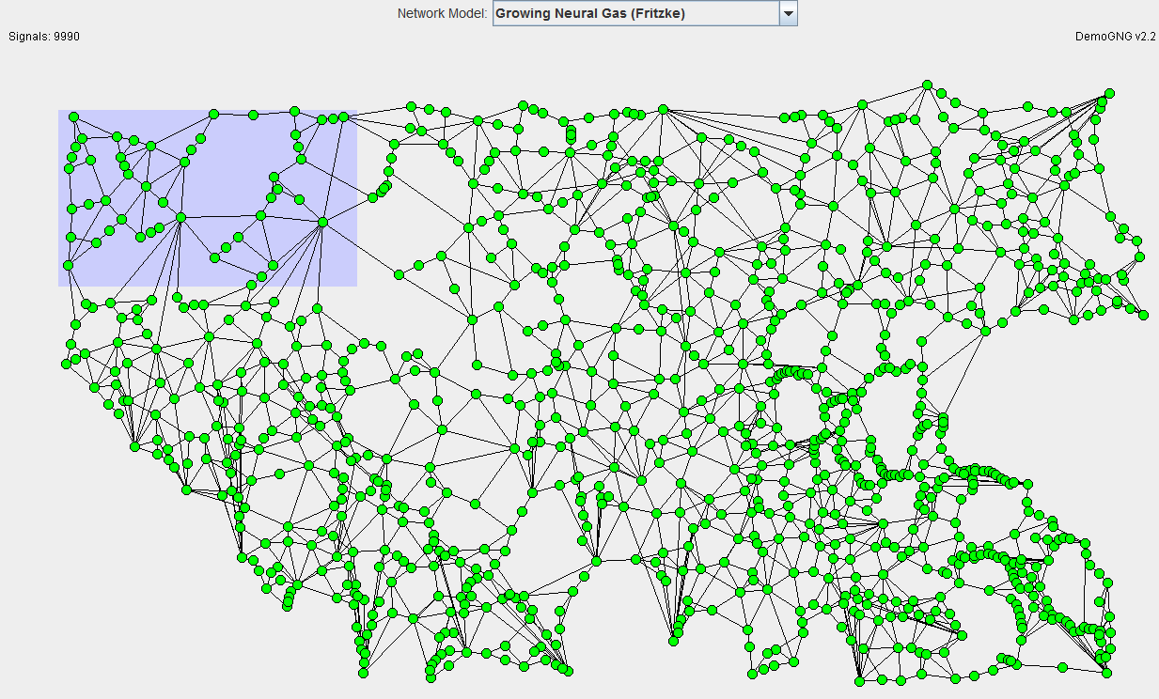
Extreme plasticity
Brain plasticity (learning) is increased if long, Slow strong emotions are involved. Followed by depressive mood it leads to severe distortions, false associations, simplistic understanding.

Slide 36
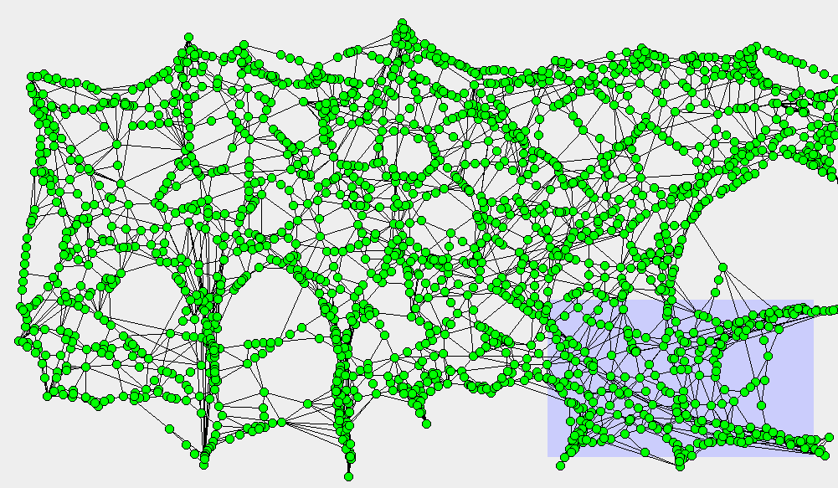
Conspiracy views
Illuminati, masons, Jews, UFOs, or twisted view of the world leaves big holes and admits simple explanations that save mental energy, creating „sinks” that attract many unrelated episodes.

Slide 37
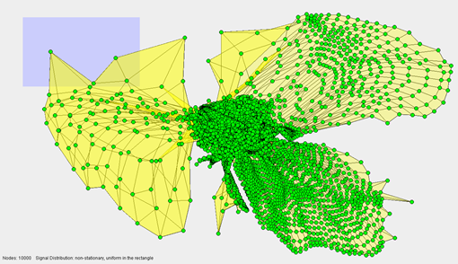
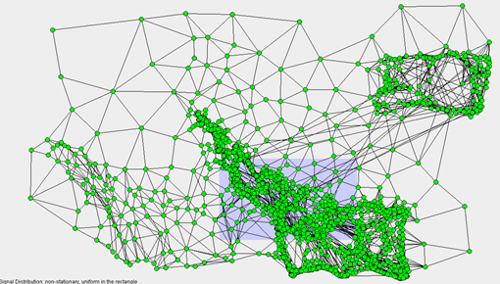
Memoids …
Totally distorted world view, mind changed into a memplex …
Ready for sacrifice.

Slide 38
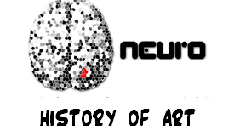
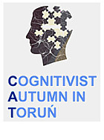
Soul or brain: what makes us human? Interdisciplinary Workshop, Toruń 19-21.10.2016
Infants, learning, and cognitive development. 4-5.11.2016 Interdoctor: Disorders of consciousness. 19-21.10.2016

Slide 39
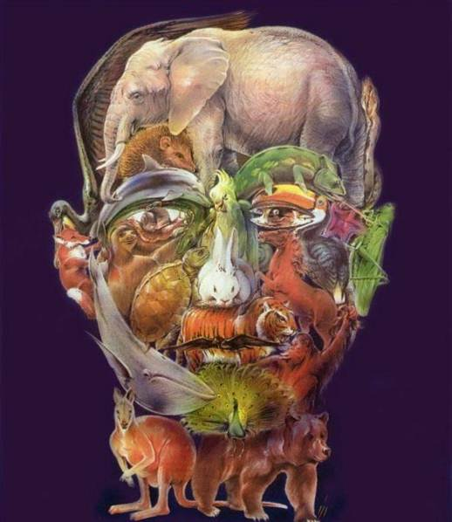
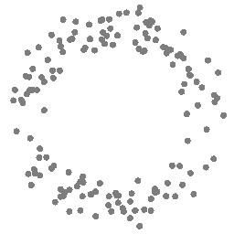
Thank for synchronization
of your neurons
Google: W. Duch => talks, papers, lectures …

Slide 41
Where is the meaning?
How should a concept meaning be represented?
No representations, only senso-motoric embodiment (robotics).
Only some concepts have shared meaning through embodiment.
Aaron Sloman (2007): only simple concepts come from our “being in the world”experience, others are compounds, abstract. David Hume gave good example: “golden mountain”.
Not symbol grounding but symbol tethering, meaning from mutual interactions.

Slide 42
Words to read
40 words, 20 abstract & 20 concrete; dendrogram shows similarity in phonological and semantic layers after training.

Slide 43
Reading and dyslexia
Phonological dyslexia: deﬁcit in reading pronounceable nonwords (e.g., “nust” (Wernicke).
Deep dyslexia like phonological dyslexia + signiﬁcant levels of semantic errors, reading for ex. “dog” as “cat”.
Surface dyslexia: preserved ability to read nonwords, impairments in retrieving semantic information from written words, difﬁculty
in reading exception, low-frequency words, ex. “yacht.” Surface dyslexia - visual errors, but not semantic errors. .
Double route model of dyslexia includes orthography, phonology, and semantic layers, direct ortho=Phono route and indirect
ortho => semantics => phono, allowing to pronounce rare words.

